Slide 1
Discrete time Fourier Series lecture 8

Slide 2
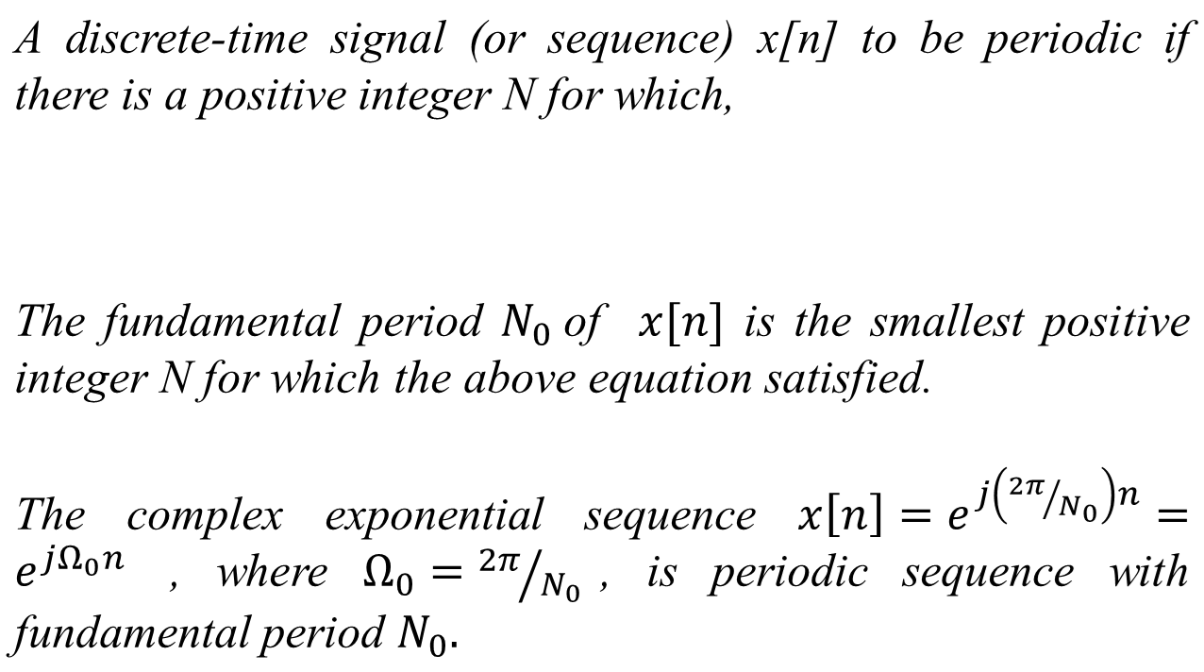
Introduction

Slide 3
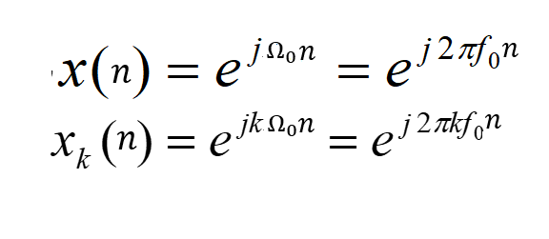
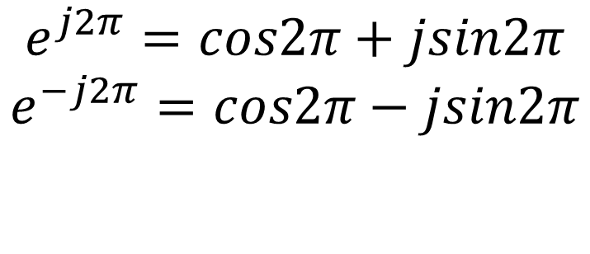
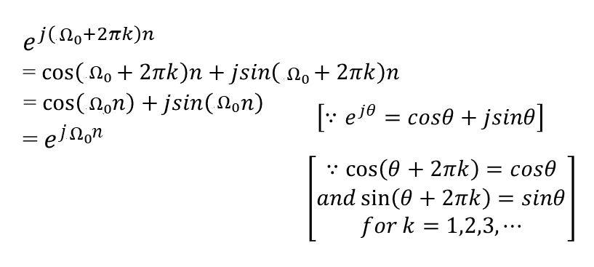
Introduction

Slide 4

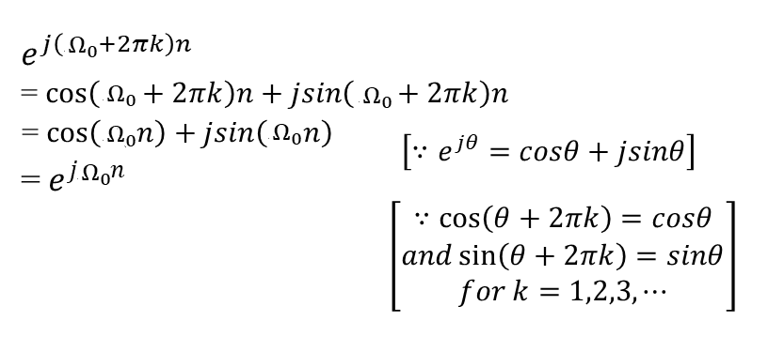
Introduction

Slide 5
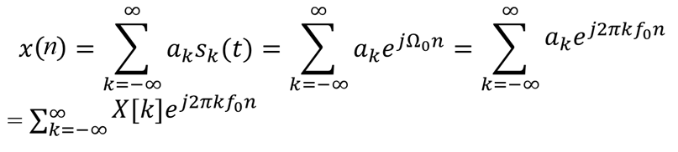
The Fourier Series
Any periodic signal (not necessarily sinusoidal, or complex exponential signals) can be expressed as the linear combination of a series of harmonically related complex exponential signals (or trigonometric functions). This is the mathematical theory of Fourier Series.
Fourier Series is a linear combination of harmonically related complex exponential of the form
s_{k}(t) = e ^{j 2π kf0n} is called the k^{th} harmonic component,
a_{k}=X[k] is the amplitude for the k^{th} harmonic component.

Slide 6
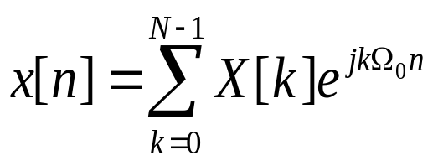
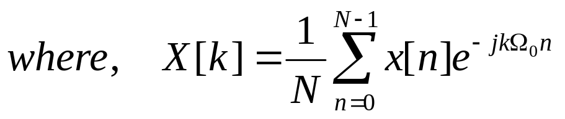
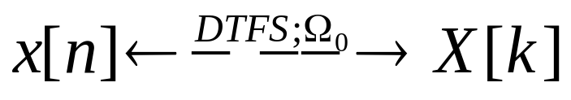
Discrete Time Fourier Series
The DTFS representation of a periodic signal x[n] with fundamental period N and fundamental frequency Ω₀=2π/N is given by
are the DTFS coefficients of the signal x[n].
We say that x[n] and X[k] are DTFS pair and denote the relationship as

Slide 7
Discrete Time Fourier Series
The DTFS coefficients X[k] are termed as frequency domain representation for x[n].
The DTFS representation is exact; any periodic discrete time signal may be described in terms of

Slide 8
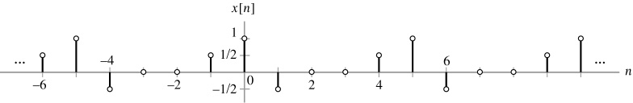
Discrete Time Fourier Series
Find the frequency domain representation of the signal depicted in figure below.

Slide 9

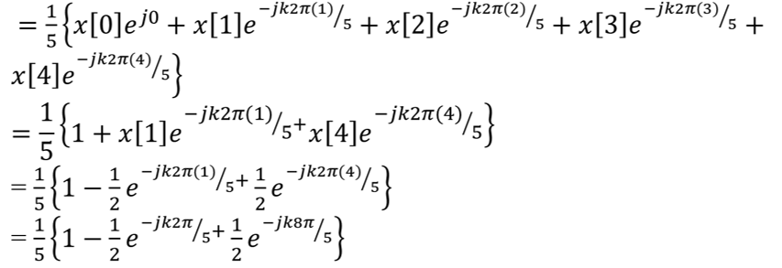
Discrete Time Fourier Series
Solution
The signal has period N=5, so Ω₀=2π/5.

Slide 10
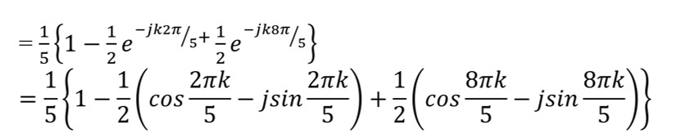
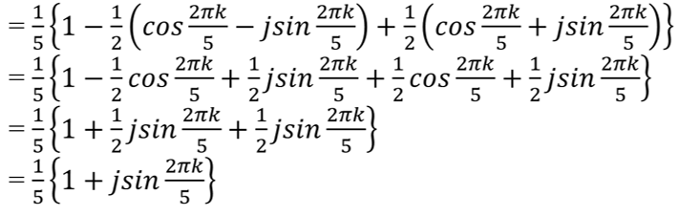
Discrete Time Fourier Series
Solution

Slide 11
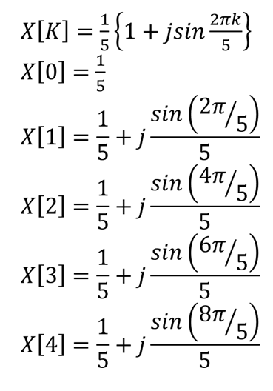
Discrete Time Fourier Series
Solution

Slide 12
Discrete Time Fourier Series
Previous Problem
Find the frequency domain representation of the signal depicted in figure below.

Slide 13
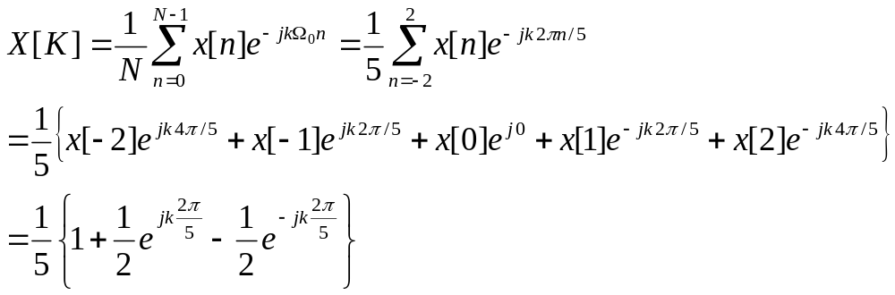
Discrete Time Fourier Series
Solution in different way
The signal has period N=5, so Ω₀=2π/5. Also, the signal has odd symmetry, so we sum n=-2 to n=2 in the equation,

Slide 14
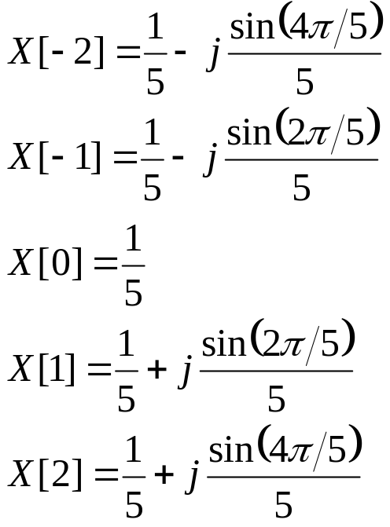
Discrete Time Fourier Series
Solution in different way
From this equation, w identify one period of the DTFS coefficients X[k], k=-2 to k=2,
It can be seen that both intervals n=-2 to n=2 and n=0 to n=4, yield equivalent expressions for the DTFT coefficients.

Slide 15
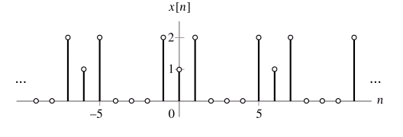
Discrete Time Fourier Series
Determine the DTFS coefficients of the periodic signals depicted in figure below:

Slide 16
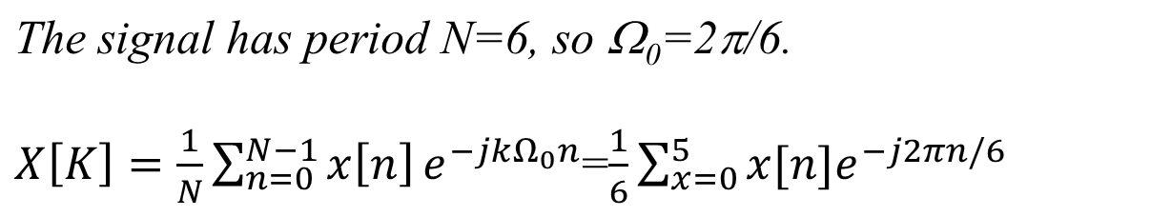
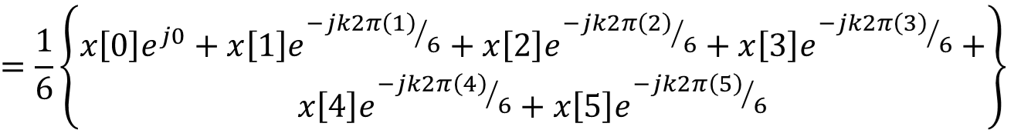
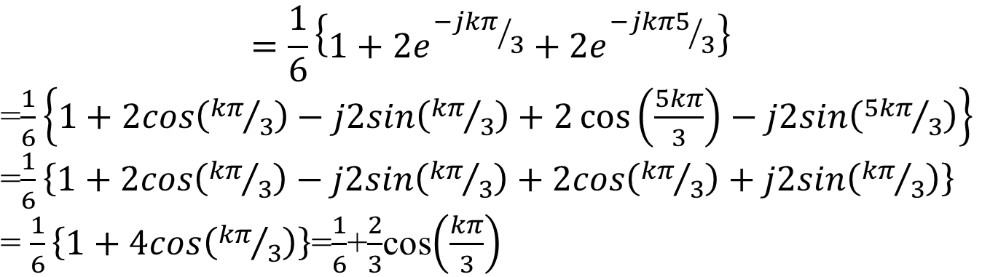
Discrete Time Fourier Series
Solution

Slide 17
Discrete Time Fourier Series
Solution

Slide 18

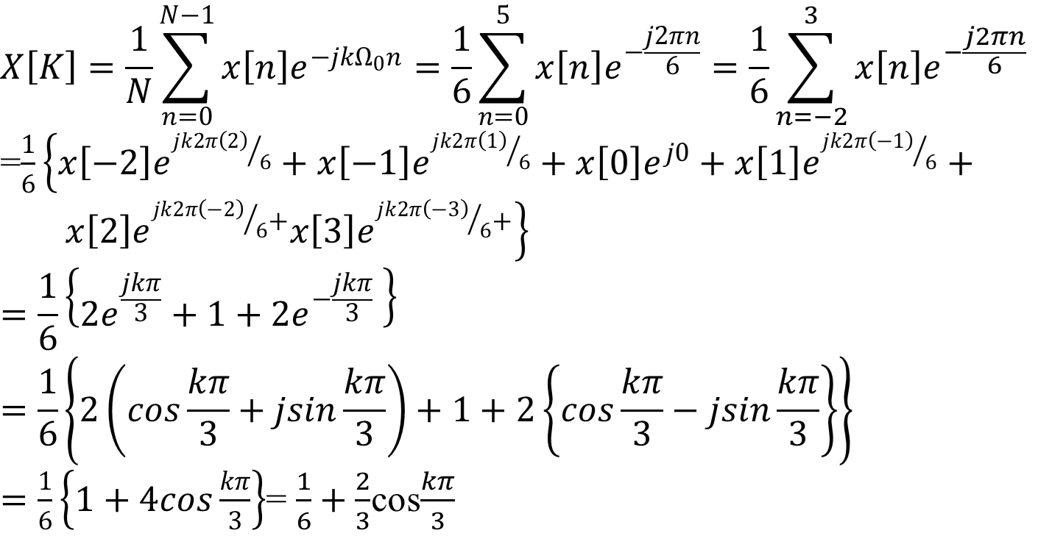
Discrete Time Fourier Series
Solution in different way

Slide 19
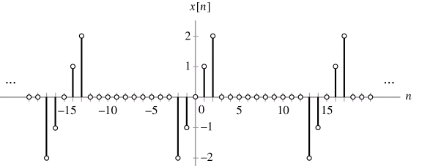
Discrete Time Fourier Series
Problem
Determine the DTFS coefficients of the periodic signals depicted in figure below:

Slide 20

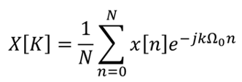
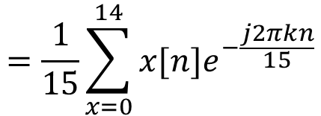
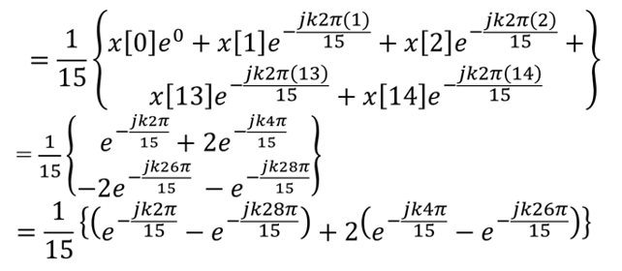
Discrete Time Fourier Series
Solution

Slide 21
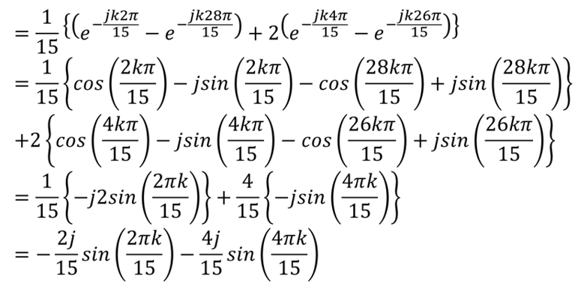
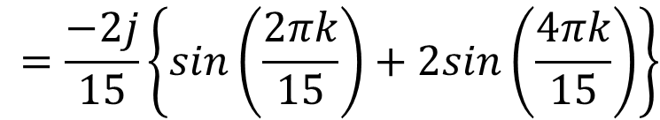
Discrete Time Fourier Series
Solution

Slide 22
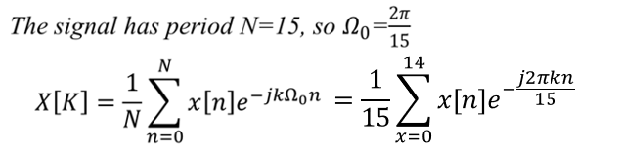
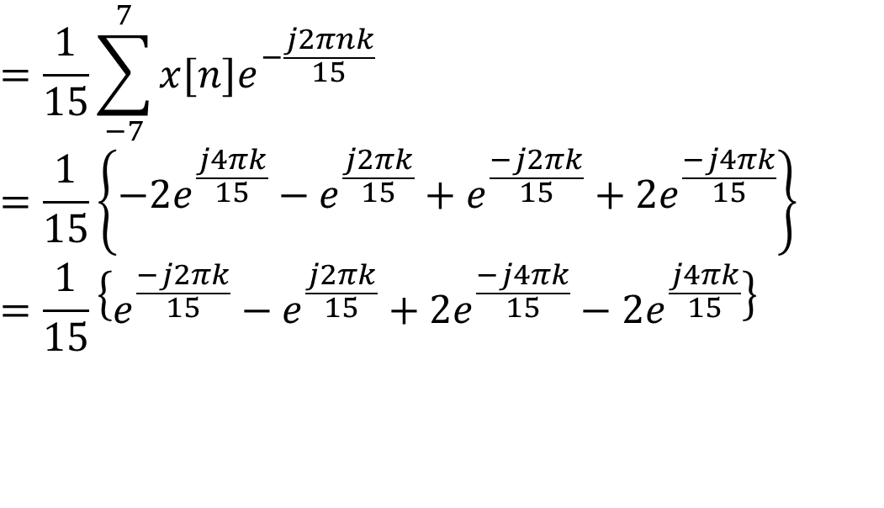
Discrete Time Fourier Series
Solution in different way

Slide 23
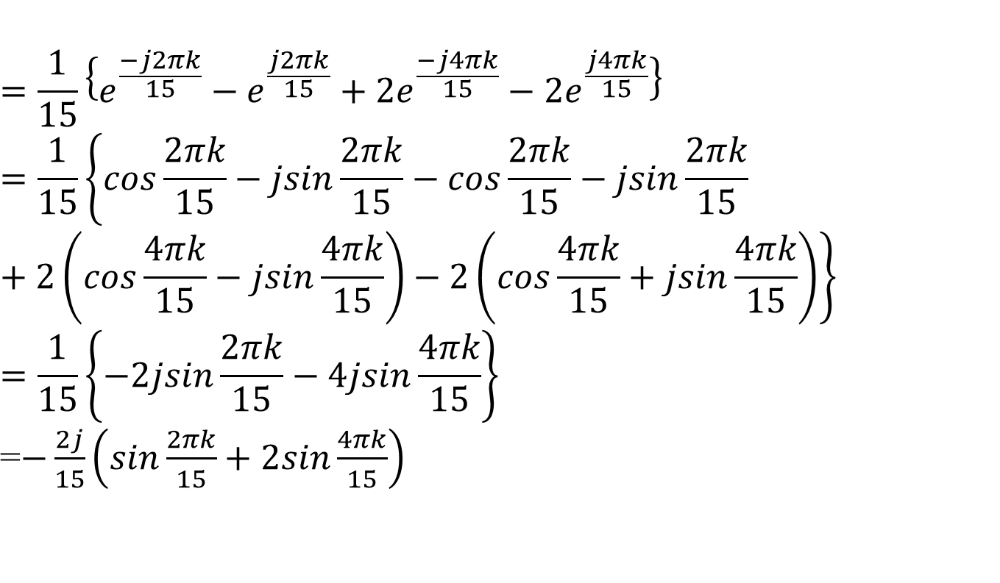
Discrete Time Fourier Series
Solution in different way

Slide 24
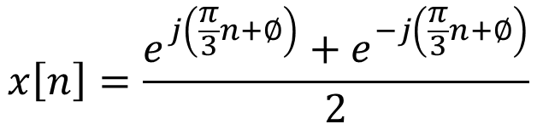
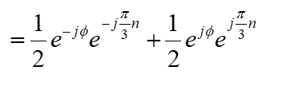
Computation of DTFS Coefficients by inspection
Problem
Determine the DTFS coefficients of x[n]=cos(πn/3+φ), using the method of inspection.
Solution
The period of x[n] is N=6. Ω₀=2π/6=π/3

Slide 25
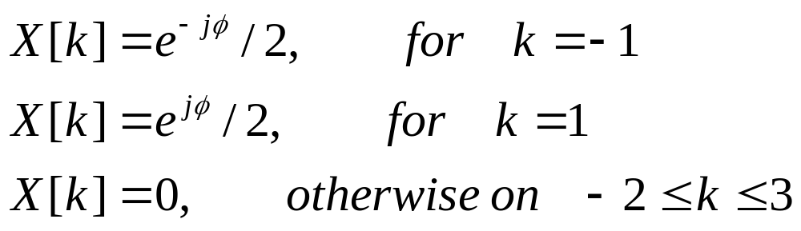
Computation of DTFS Coefficients by inspection
Solution
Thus, the Fourier series coefficients for this example are

Slide 26
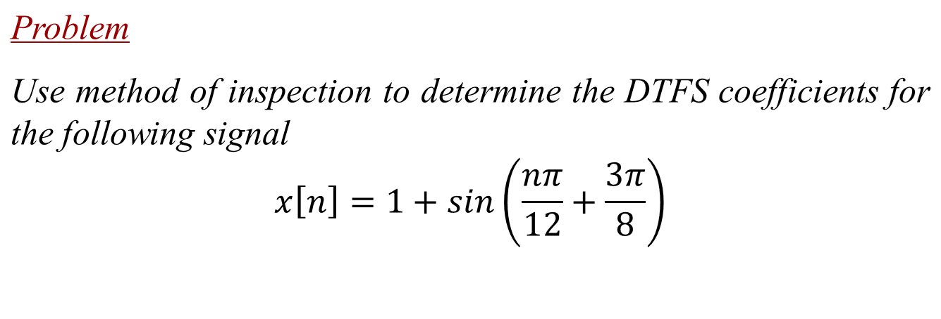
Computation of DTFS Coefficients by inspection
Solution
The period of x[n] is N=24, Ω₀=2π/24=π/12

Slide 27
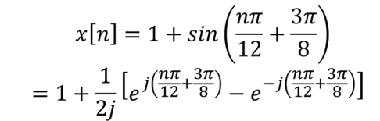
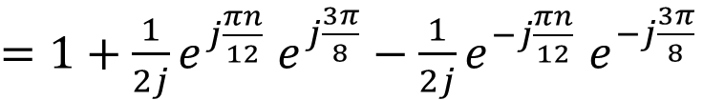
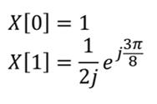
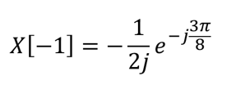
Computation of DTFS Coefficients by inspection

Slide 28
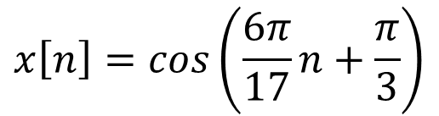
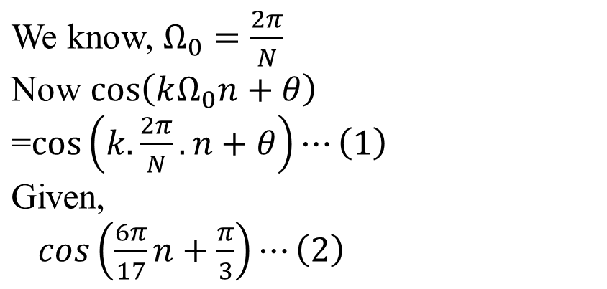
Computation of DTFS Coefficients by inspection
Problem
Use method of inspection to determine the DTFS coefficients for the following signal
Solution

Slide 29
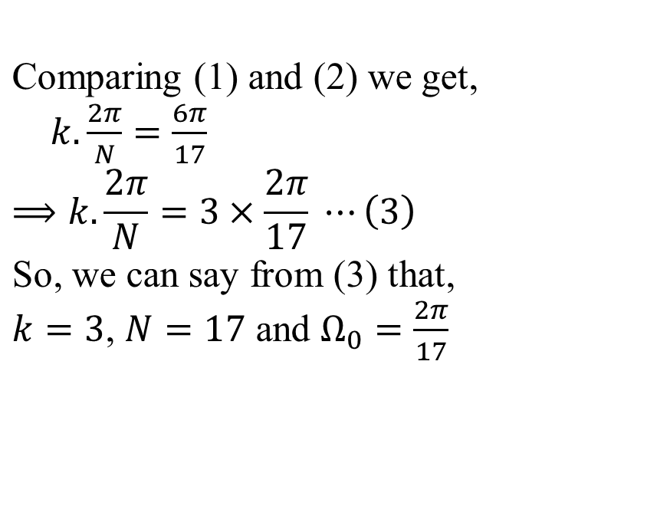
Computation of DTFS Coefficients by inspection
Solution

Slide 30
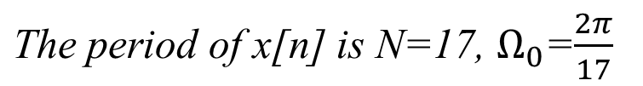
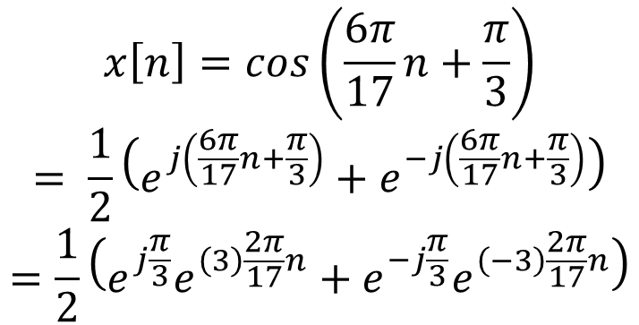
Computation of DTFS Coefficients by inspection
Solution

Slide 31
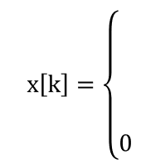
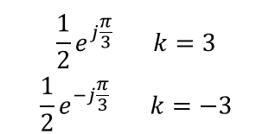
Computation of DTFS Coefficients by inspection
Solution

Slide 32
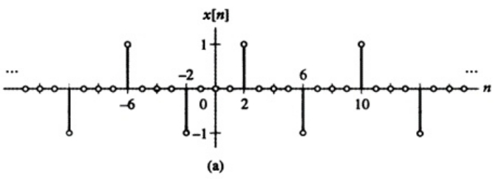
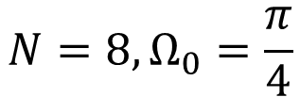
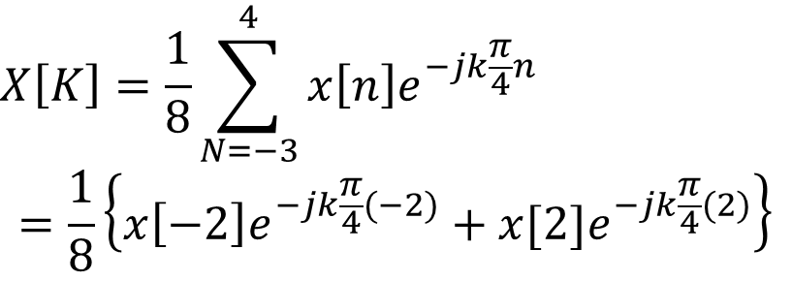
Computation of DTFS Coefficients by inspection
Problem
Determine the DTFS coefficients of the periodic signals depicted in figure below:

Slide 33

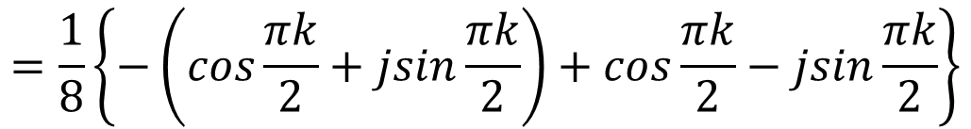
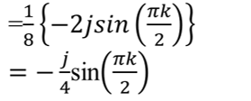
Computation of DTFS Coefficients by inspection
Solution

Slide 34




Computation of DTFS Coefficients by inspection
Problem
Determine the DTFS coefficients of the periodic signals depicted in figure below:

Slide 35


Computation of DTFS Coefficients by inspection
Solution

Slide 36

The Discrete time Fourier Series
Problem
Determine the time domain signal x[n] from the DTFS coefficients depicted in figure below.
Figure: Magnitude and phase of DTFS coefficients

Slide 37





The Discrete time Fourier Series
Solution

Slide 38

The Discrete time Fourier Series
Solution

Slide 39
End

